Slide 1
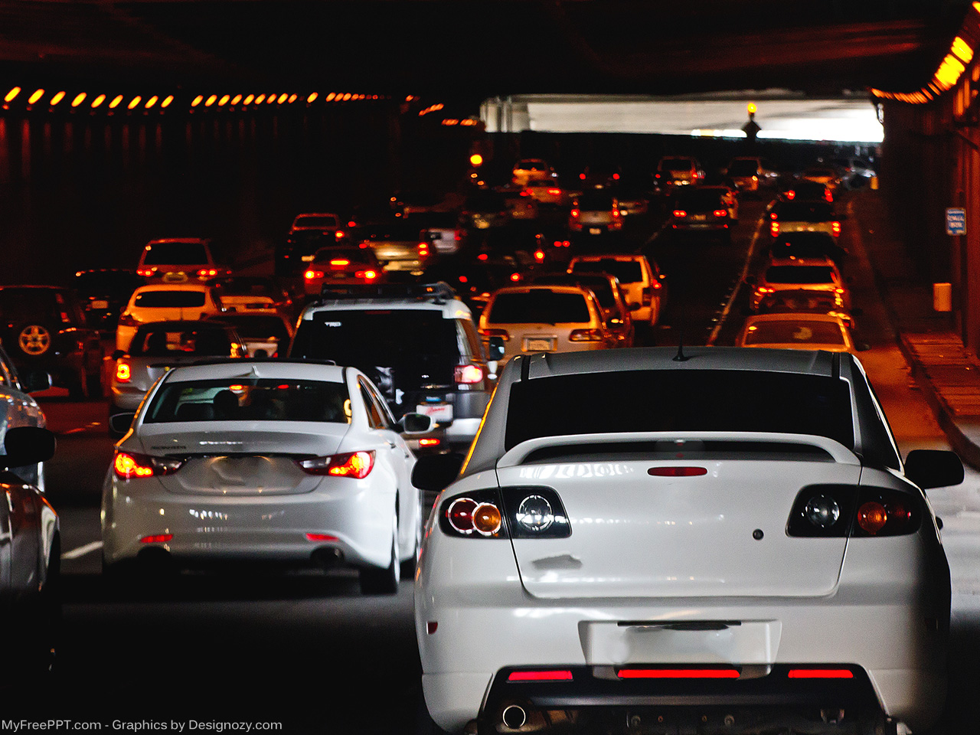
When To Uber or When Not to Uber??
Uber Driver vs Uber Passenger Perspective
Noreen Malik
Ed McCoy
Divya Tresa
Joyce D. Williams

Slide 2
Background
New York City Taxi & Limousine Commission dataset
Over 1.1B individual taxi trips (Jan. 2009 – Jun. 2015)
Includes Yellow and Green taxis
2016 added - covering taxis, Uber, and other For-Hire Vehicle (FHV) trips through Jun. 2016
Dataset has 1.3B trips
FiveThirtyEight
Publicly available datasets for 19M Uber rides in NYC (Apr. – Sept. 2014 and Jan. – Jun. 2015)
Updated Mar. 2018
Data collected through Dec. 2017
Over 1.4B taxi trips
400M FHV trips ride-hailing apps
Uber
Lyft
Juno
Via

Slide 3
Project Requirements (Laymen Terms – What is Your Motivation Behind This)
Determine what would be the best (date and time) to go active as an Uber driver?
Driver wants to make the most $$$
Determine what would be the best (date and time) to schedule an Uber ride?
Rider wants to pay the least $$$

Slide 4
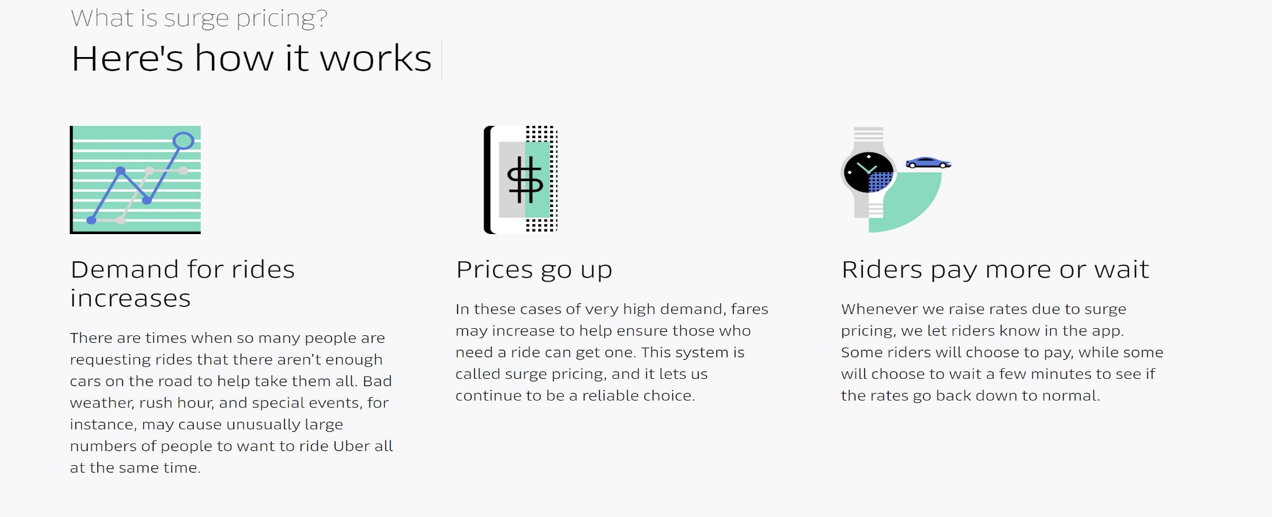
What is “Surge Pricing”?

Slide 5
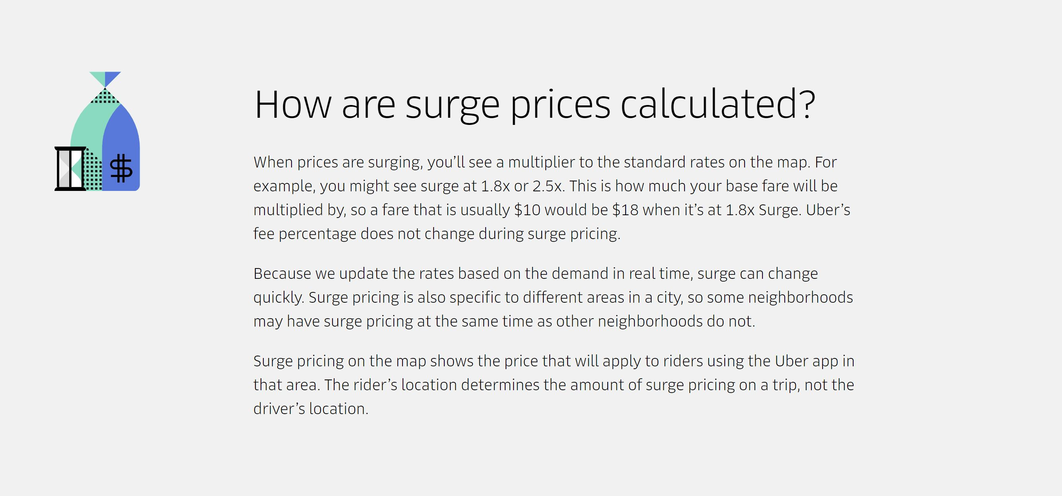
Why Care About “Surge Pricing”?

Slide 6
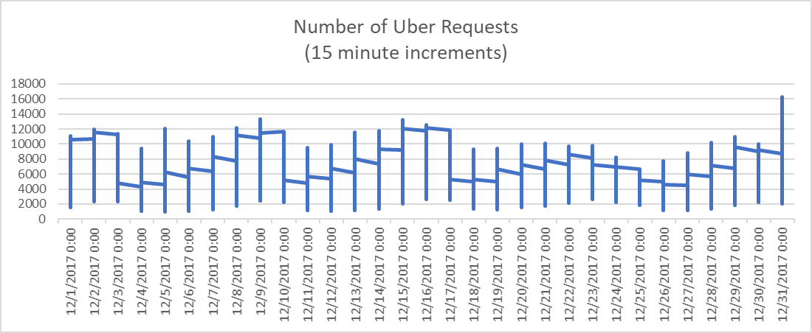
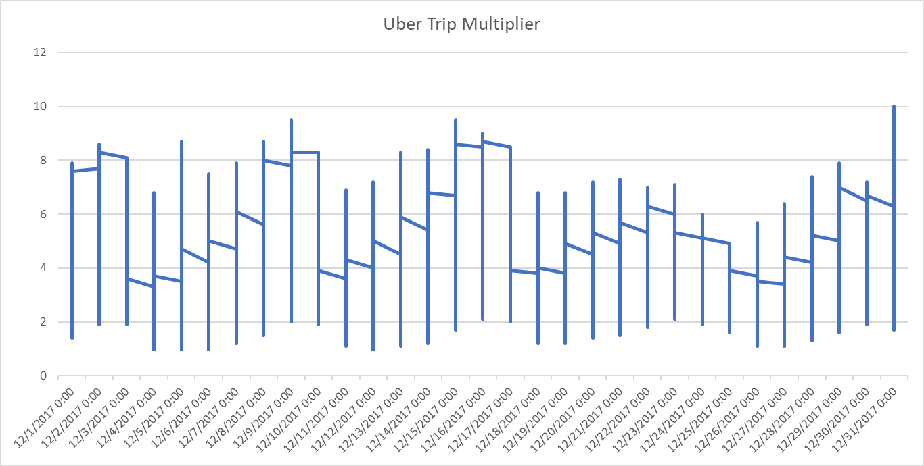
Conversion of Uber Requests to Multiplier
Higher multiplier favors the driver, Lower multiplier favors the passenger!!!

Slide 7
Data Analysis
Uber trips only
Trips to/from New York City (Tri-state area)
Narrowed coinciding events to
Basketball
Football
Hockey
December 2017
Over 12M trips for the month!!!
Most recent data

Slide 8

Putting Our Theory To The Test (Select Events)
12/9/17
8:00PM
Hockey Game (Devils at NY Rangers)
Attendance: 18,006 @ Madison Square Garden
12/9/17
6:00PM
Basketball (New York Knicks vs Chicago Bulls)
Attendance: 20,149 @ United Center
12/15/17
7:00PM
Basketball (New York Knicks vs Chicago Bulls)
Attendance: 17,756 @ United Center
12/9/17
7:00PM
Hockey Game (NY Islanders at Boston Bruins)
Attendance: 17,565 @ TD Garden, Boston, MA
12/9/17 (Televised)
6:00PM
Basketball Game (Miami Heat Vs Brooklyn Nets)
Capacity: 22,300, Mexico City Arena
Mexico City, Mexico
12/31/17
Starting around 9:00PM – 12:00
New Years Eve
Attendance: Parties, clubs, etc.

Slide 9
Event and Multiplier Comparison
Event
Multiplier

Slide 10
Resources Used
Python
Pandas
Jupyter Notebook
Tableau
Excel
Web Scraping API
JSON

Slide 11
Challenges Encountered
Extremely large dataset
Original dataset >260GB
Limited computing power for downloading as well as processing
Storage space

Slide 12
Moving Forward
Incorporate Artificial Intelligence (AI)
Machine Learning
Neural Networks (NN)
Train to predict demand for future events based on prior demand
More computing power
Better, faster way to scrape information sources
Past events

Slide 13
Questions/Answers

